Slide 1

FRONT END FOR
CHAT APP
“Task-2”

Slide 2

CHAT APP:
It enables you to send and receive messages. Chatting apps make it easier, simpler, and faster to connect with everyone and it is also easy to use. There are many types of chatting apps and every one has its own format, design, and functions.
NM ID | NAME | BATCH
au820420205013 | Arun R | CF1
au820420205018 | Divya R | CF1
au820420205028 | Jothikumar K | CF1
au820420205033 | Mahalakshmi S | CF1

Slide 3

Task - 2
Create UI and implement various components using react
Split design into components and Higher order Components
Define structure of the components
Set the basic ui components with dummy data
●
●
●
Integrate the APIs to frontend to ensure the dynamic feature of website
Point base api to the severs base url
Design api calls for each element
Handle errors in the output
Render output of apis to different low level components
Secure content of post apisx
●
●
●
●
●
Evaluation Metric:
● 100% Completion of the above tasks
Learning Outcome
▪
▪
▪
▪
Developing complicated UI using react components
Using props drilling and context to pass variables
Getting familiar with different type of api calls
Handling different input data

Slide 4

Step-Wise Description
Import Necessary Libraries: Import libraries like random to generate random values and, if needed, a library like Tkinter for a simple GUI.
Generate Random Values: Use the random library to generate random values for the red, green, and blue color channels. You can use random.randint(0, 255) for each channel.
Format the Color: Combine the random values to create a color. In HTML/CSS, it's usually represented as rgb(r, g, b).
Display the Color: If you want a GUI, create a window (if using Tkinter), and display the generated color. If you're using a command-line interface, you can print the color.
Repeat or Exit: Depending on your application, you can choose to generate more colors in a loop, or exit the program.
Summary of your task
Creating a random color generator entails importing relevant libraries (e.g., 'random' and 'Tkinter' for a GUI), generating random RGB values, formatting them as 'rgb(r, g, b),' displaying the color, and making a choice to continue generating colors or exit the program. Customization and features can be added based on your project's requirements.

Slide 5
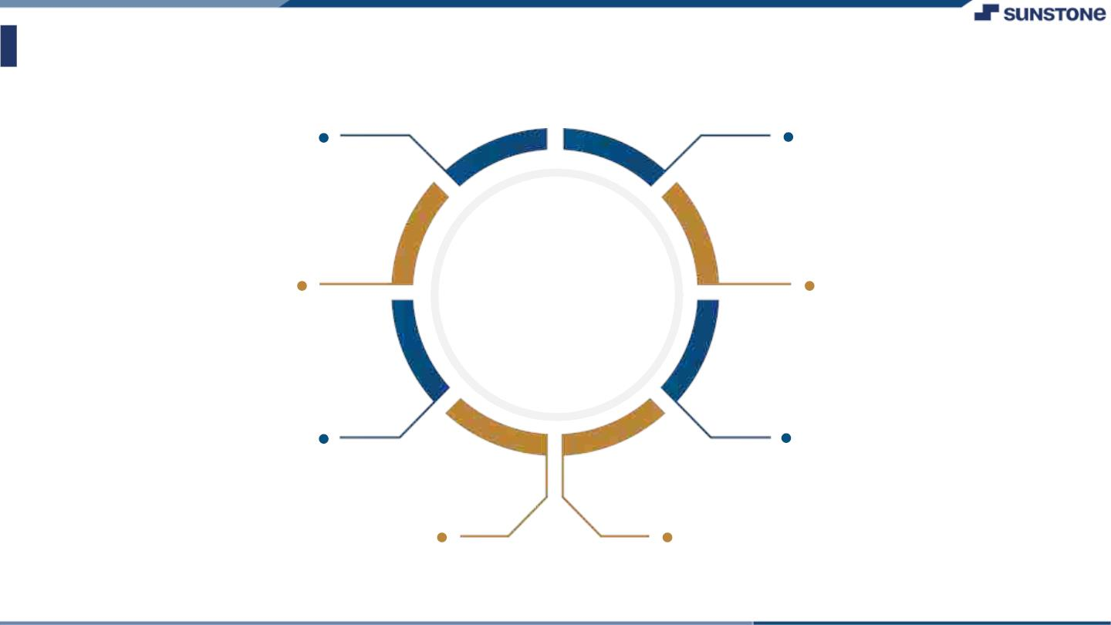
Assessment Parameter
Gather requirements for the
project
Add Readme.md file with description of the project
Prepare database design
schemas
Check-List
Commit all changes with "first commit"
Get your initial project
Structure ready
Create a repository on github realted to project
Initiate a
Initiate a git repository
Push your changes to github

Slide 6

Submission Github
https://github.com/ArunR4/NM2

Slide 7


